Slide 1

Mongodb queryRealtion
by Deepak manohar

Slide 2
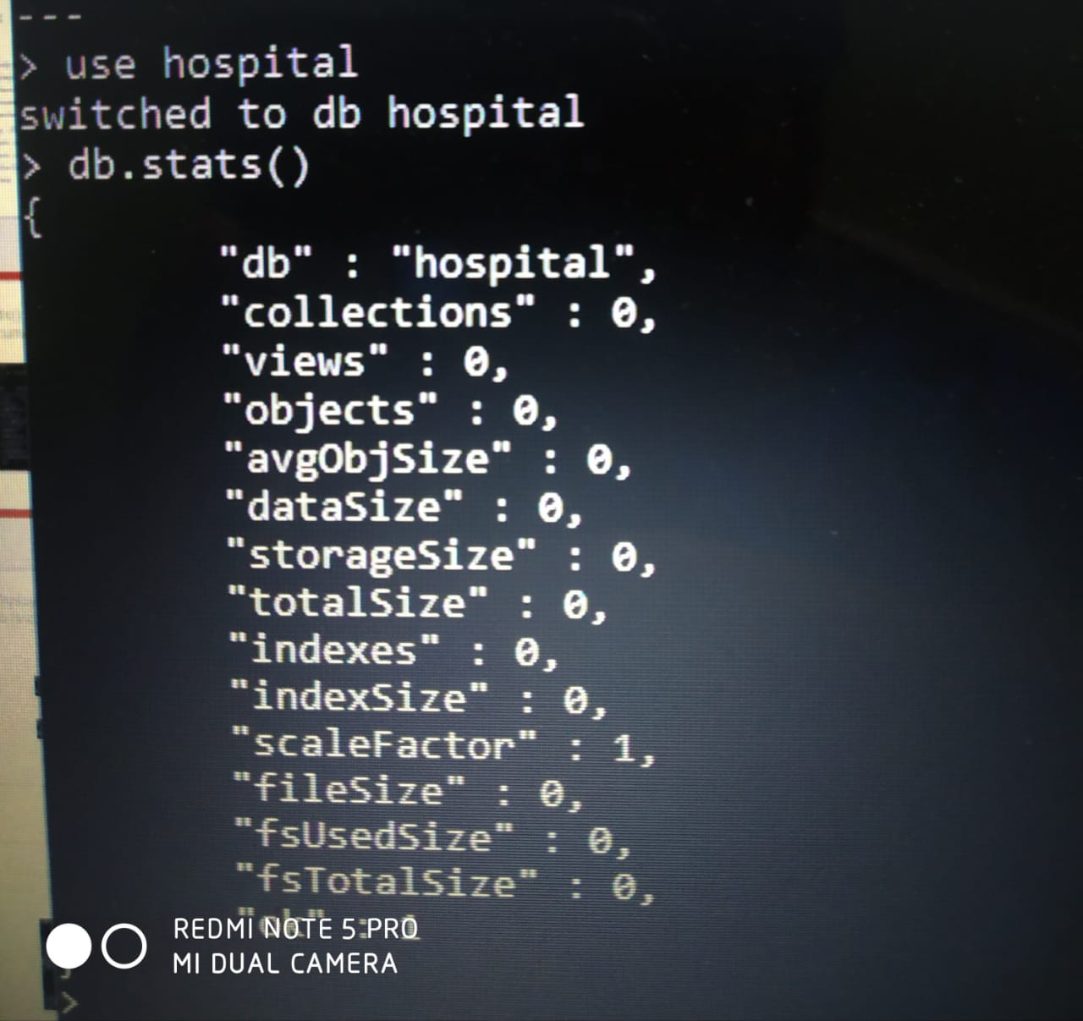
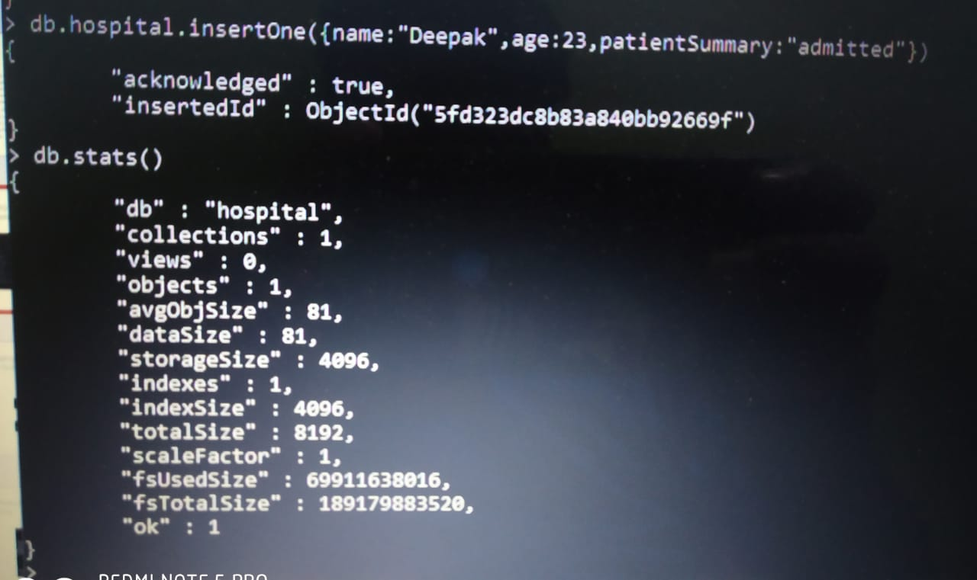
Stats() before & after inserting Document

Slide 3
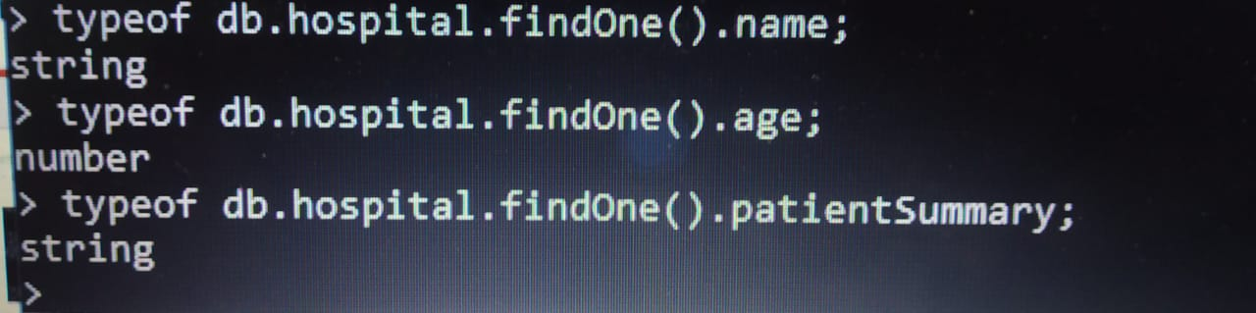
Display using variable To find datatype of variable

Slide 4
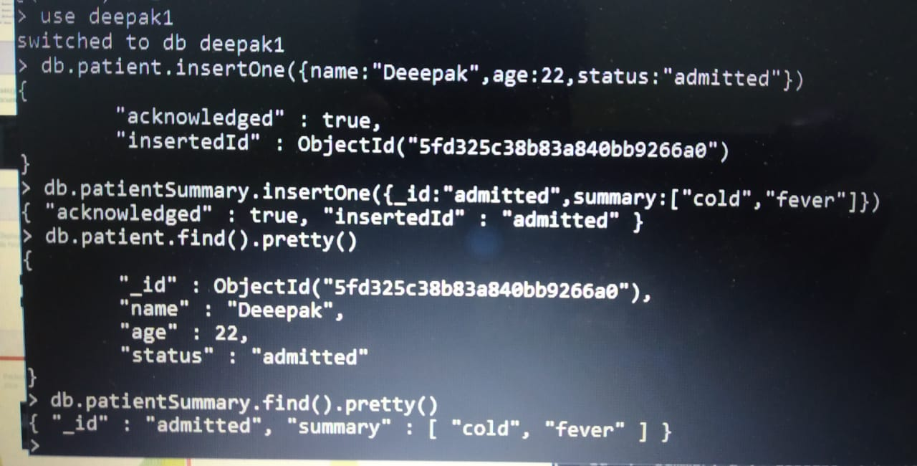
Patient-Pantientsummary Relationship (one - one)

Slide 5
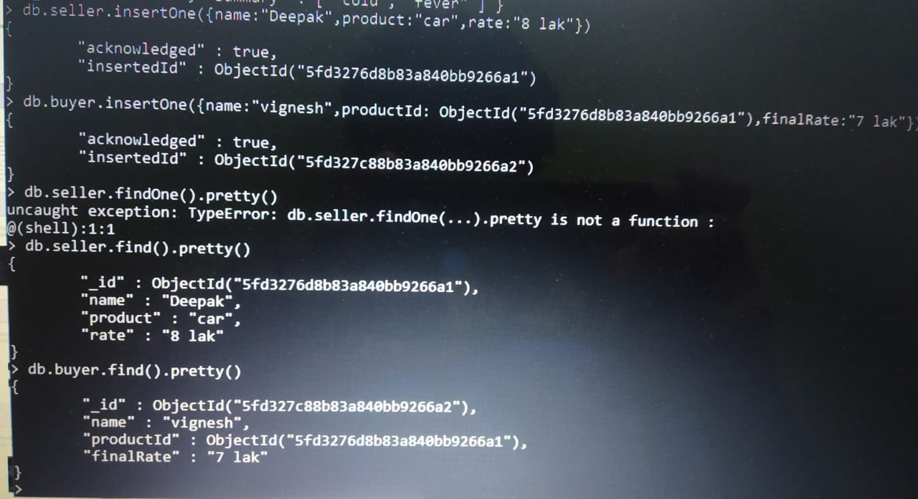
Seller-Buyer Relationship (One - One)

Slide 6
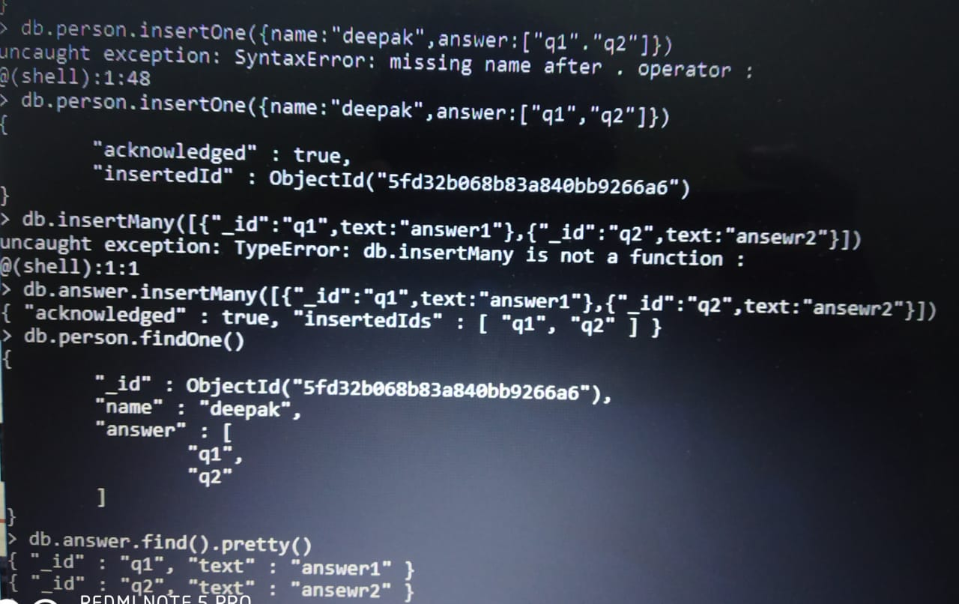
Question – Answer Relationship (One - Many)

Slide 7
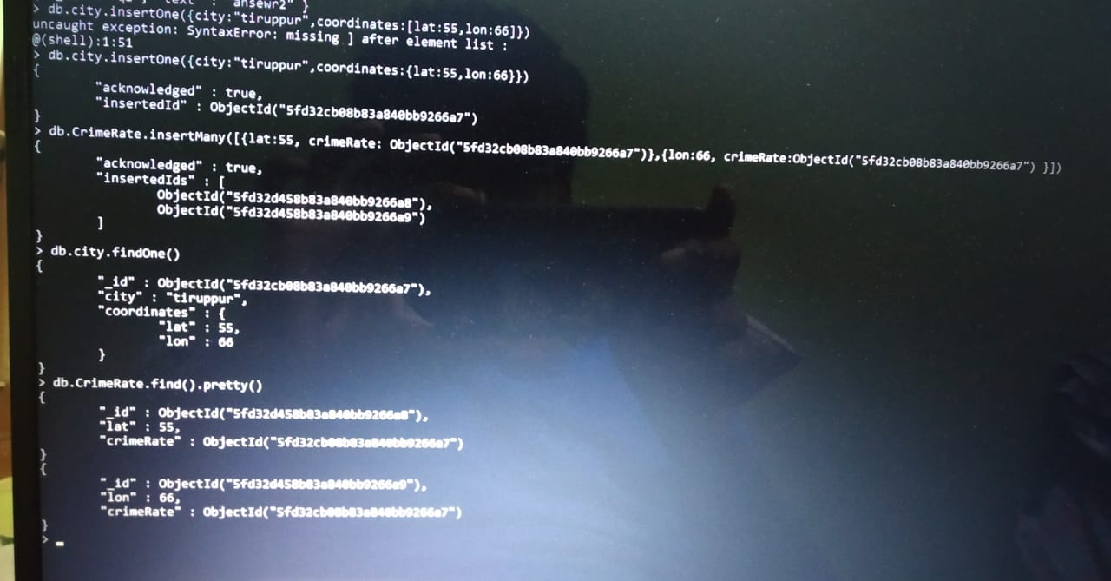
City – CrimeRate Relationship (One - Many)

Slide 8
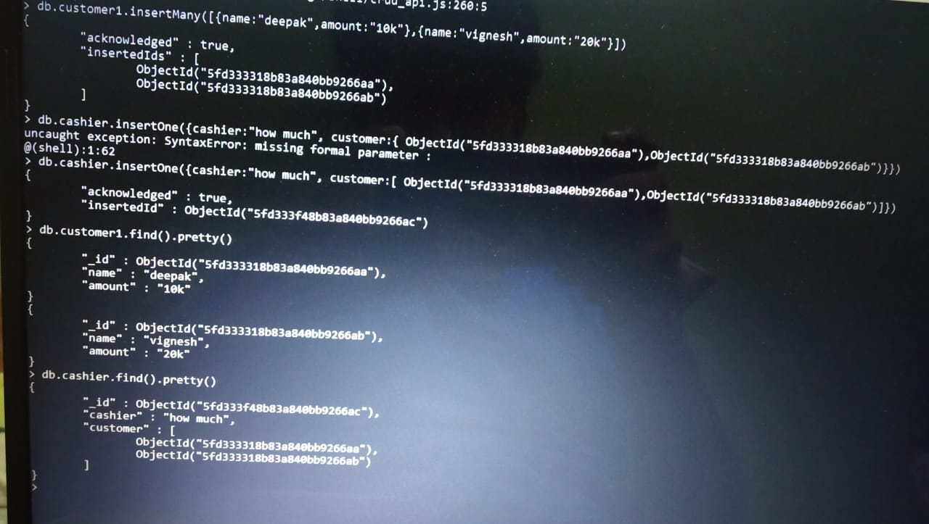
customer – cashier Relationship (Many - One)

Slide 9
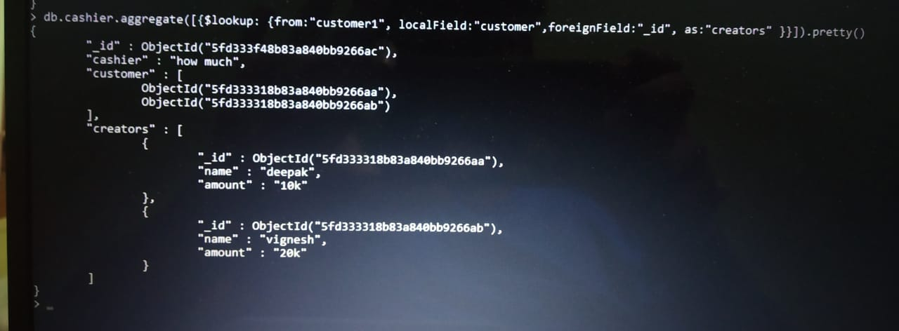
Cashier- (Aggregate)

Slide 10
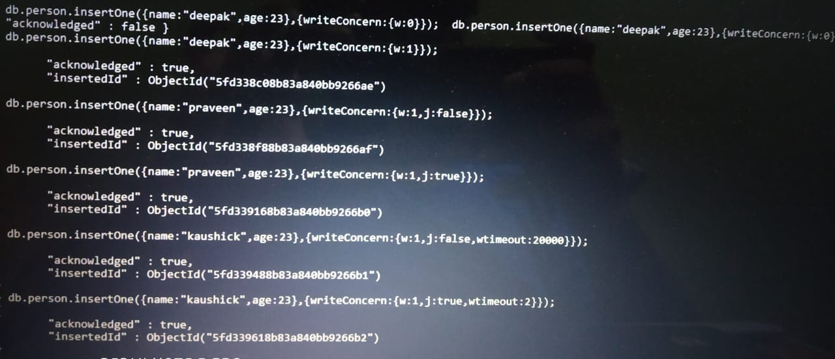
Write Concern

Slide 11
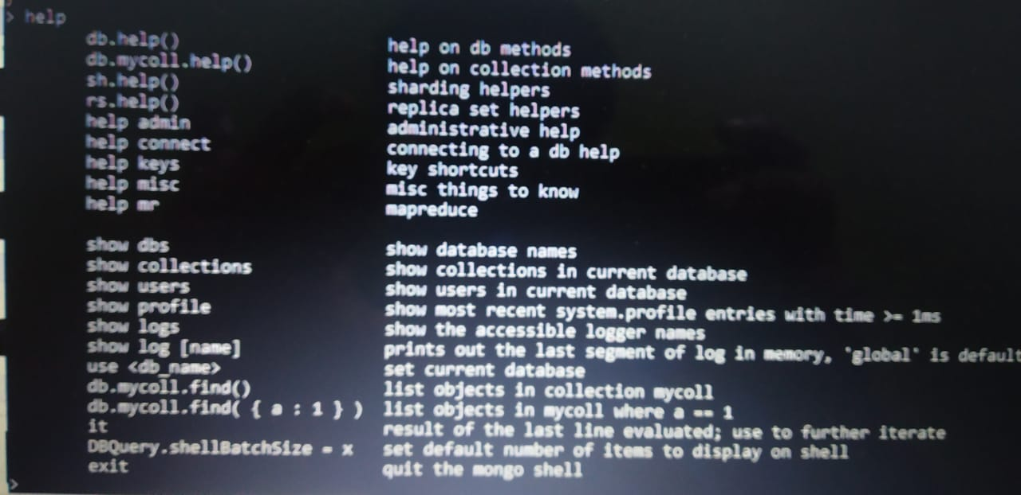
Help

Slide 12
Collection help Database methods Admin help
Collection help:
db.collectionname.help();
Database methods:
db.help();
Admin help:
Help admin;

